Slide 1
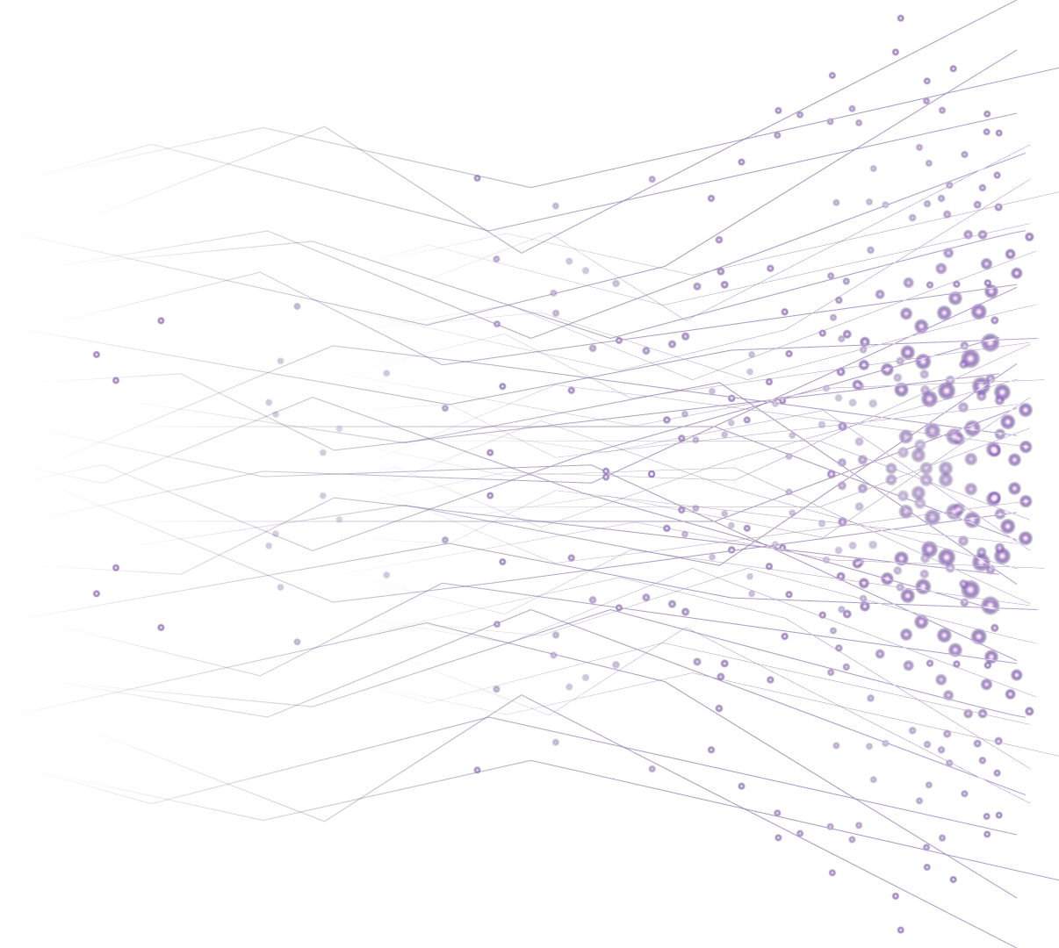

Introduction to
Computer
Programming

Slide 2
Variables & Data (A Sneak Peek in Python)

Slide 3
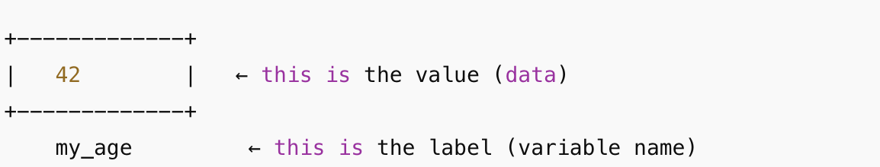
Variables as “labeled boxes” for data
A variable is like a labeled box where you can store data. The box has:
A label → the variable name
A value inside → the data stored (like a number, text, list, etc.)

Slide 4
Basic data types (int, float, string)
An int is a whole number — no decimal point.
age = 25
year = 2025
temperature = -5
type(age) # Output: <class 'int'>
A float is a number with a decimal point.
height = 5.9
price = 99.99
temperature = -3.14
type(height) # Output: <class 'float'>

Slide 5
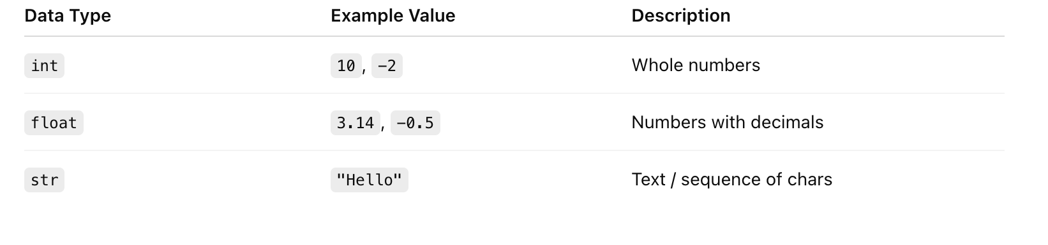
Basic data types (int, float, string)
A string is a sequence of characters — letters, numbers, symbols — enclosed in quotes.
name = "Alice"
greeting = 'Hello, world!'
zipcode = "12345" # Still a string because it's in quotes

Slide 6
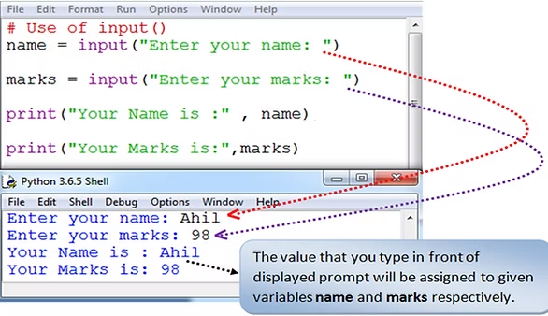
Assigning & printing in Python

Slide 7
Let’s do some hands on !

Slide 8
THANK YOU

